Slide 1
CS 6366 – Final Project Environmental Mapping
Su Yang – sxy161730
Haiyang Lou – hxl164530

Slide 2
Why we do this?
When we are doing with the graphics objects, we have following issues:
Many objects are glossy or transparent
Glossy/Transparent objects reflect the external world (Reflection)
The world is refracted through transparent objects (Refraction)

Slide 3
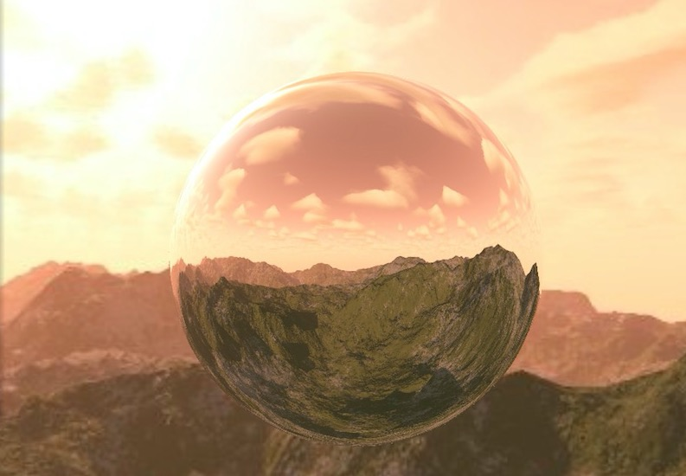
Reflection

Slide 4
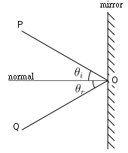
Reflection
With Normal perpendicular to the reflection side
Θin=Θreflective
Θin is the angle between light_in and normal
Θreflective is the angle between light_re and normal

Slide 5
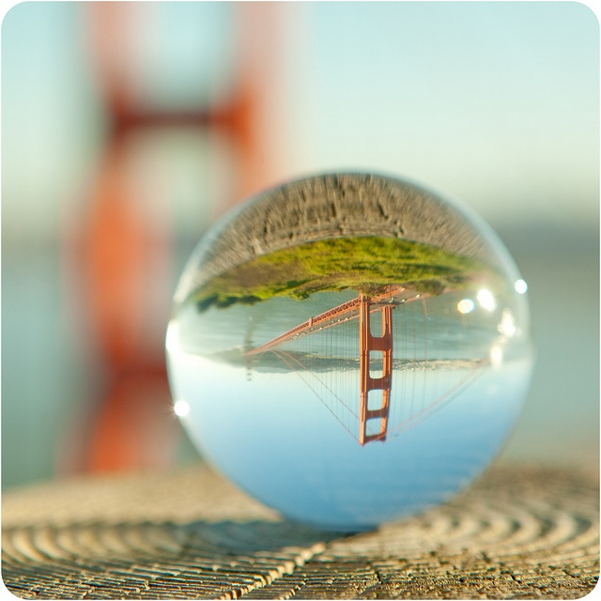
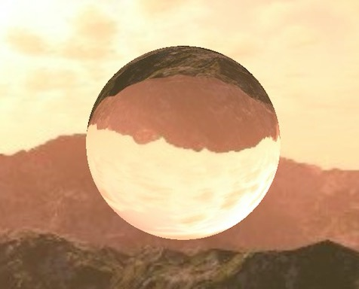
Refraction

Slide 6
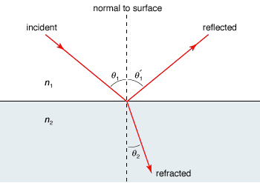
Refraction
Snell’s law.
n1sinθ1=n2sinθ2
θ1 is the angle between incident light and normal
θ2 is the angle between normal an𝑑 refracted light

Slide 7
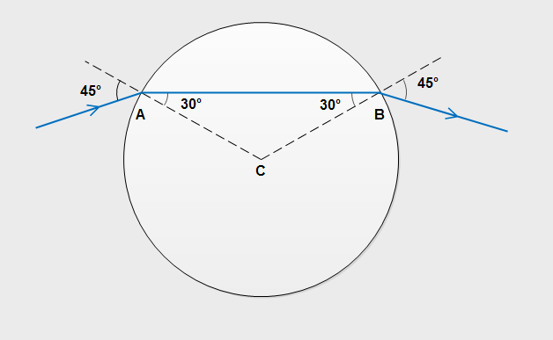
Refraction
However, what we should notice here is, when we are refracting with an sphere object (e.g. sphere glass), the bottom and topside of the refractions in our sphere will be reversed with the real scene, this is because:

Slide 8
Changeable Objects
Cubic objects
Sphere objects (2048 polygons, which gives us a more obvious and clear vision of refraction)
Hebdomicontadissaedron (72 polygons, which shows reflection aesthetically)
Rock object
Cyborg object

Slide 9
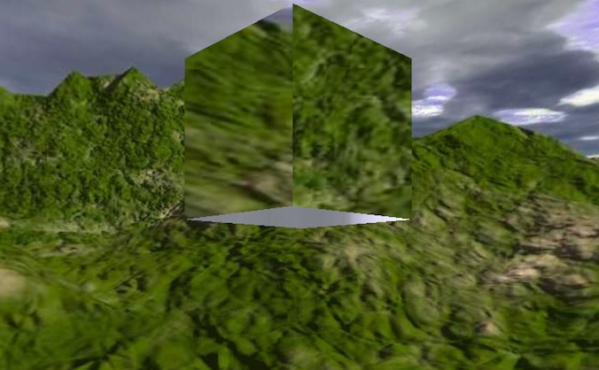
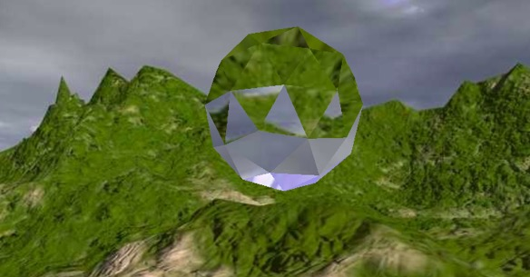
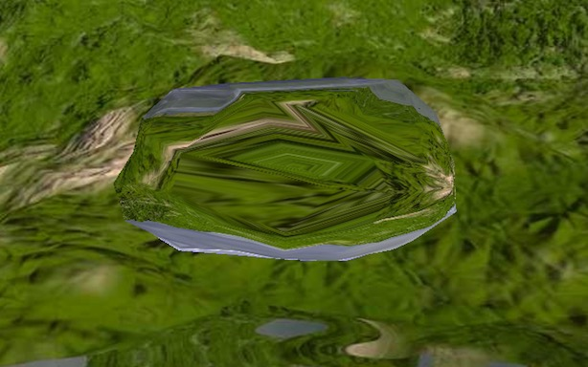
Objects

Slide 10
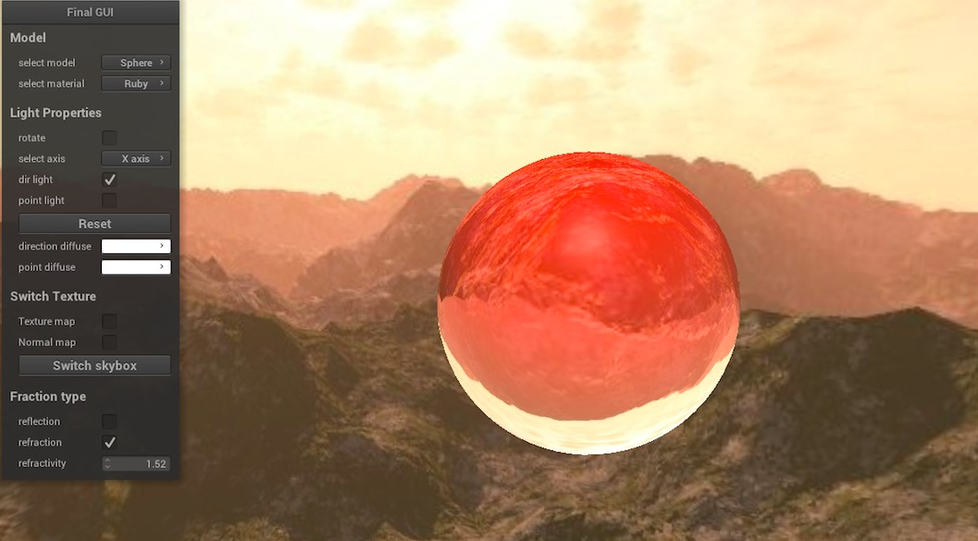
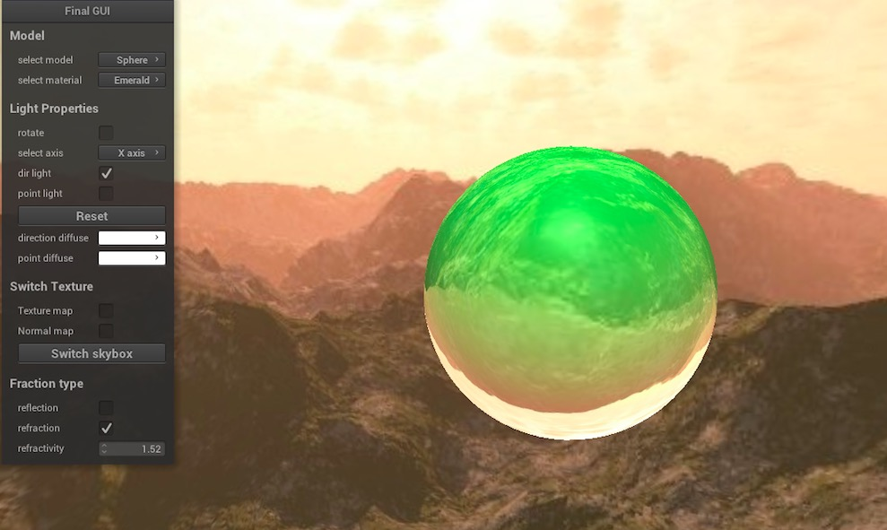
Materials
Materials : Ruby and Emerald
Change the parameter of the ambient, diffuse, specular and shininess
Different reflection/refraction effects will be displayed based on different types of objects we use.

Slide 11
Reference
https://www.pinterest.com/pin/26458716530293441/
https://learnopengl.com/
https://learnopengl.com/#!Advanced-OpenGL/Cubemaps

